Slide 1
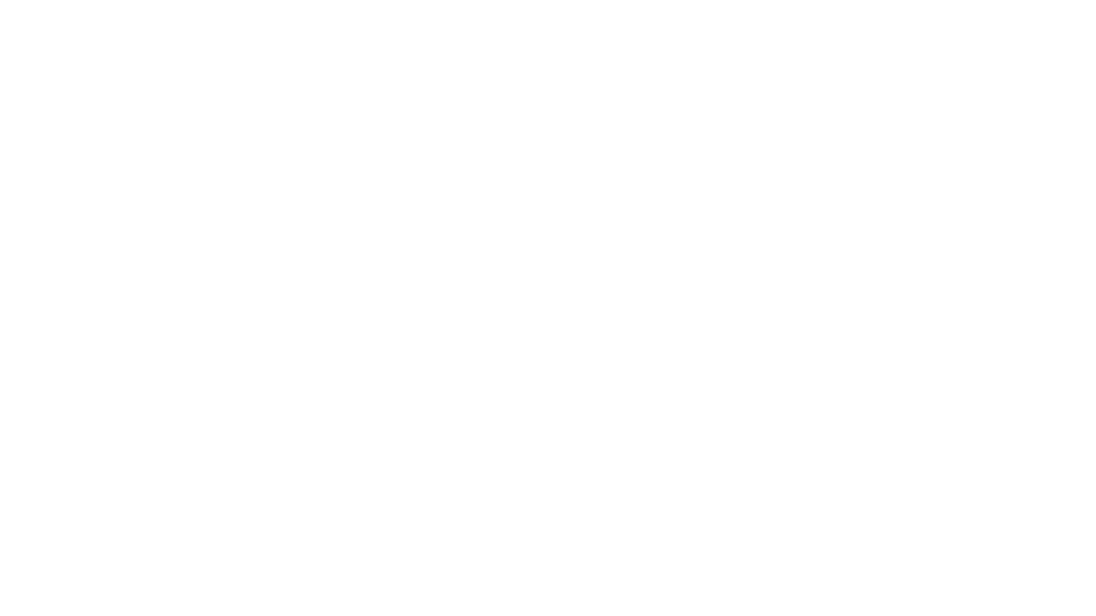
Adaboost regressor

Slide 2

Definition
AdaBoost Regressor is a machine learning algorithm used for regression tasks. It combines multiple weak learners (often simple decision trees) to create a strong regression model.

Slide 3
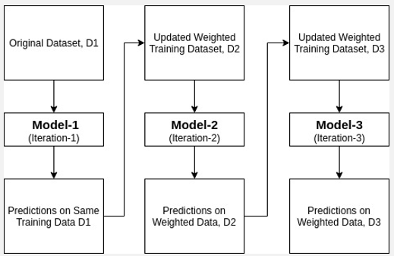
Image representation

Slide 4
Working Principle:
Initialization: Each data point is given equal weight.
Training:
A weak learner is trained on the dataset.
It focuses more on data points with higher weights.
Errors are noted, and weights are updated.
Iterative Learning:
Repeat the training process with updated weights for a specified number of iterations.
Each weak learner improves the model's performance by focusing on difficult-to-predict data points.
Combination:
Combine the predictions of all weak learners, weighted by their performance.
Generate the final prediction.

Slide 5
Advantages:
High Accuracy: AdaBoost can achieve high accuracy by combining multiple weak learners.
Versatility: It can be used with various weak learners and different types of data.
Less Prone to Overfitting: AdaBoost reduces overfitting by focusing on difficult cases.
Disadvantages:
Sensitive to Noisy Data: AdaBoost is sensitive to noisy data and outliers.
Computationally Expensive: Training multiple weak learners can be computationally expensive.
Requires Tuning: Parameters like the number of iterations need to be tuned for optimal performance.

Slide 6
AdaBoost Regressor:
class sklearn.ensemble.AdaBoostRegressor(estimator=None, *, n_estimators=50, learning_rate=1.0, loss='linear', random_state=None)
The AdaBoostRegressor class in scikit-learn is used to create an AdaBoost ensemble for regression tasks. Here's a breakdown of its parameters:
estimator: The base estimator to be used for the weak learners. By default, it uses a DecisionTreeRegressor with max_depth=3. You can also specify your own estimator controls the step size at each iteration while moving towards the optimal solution. Default is 1.0.
loss: The loss function to use when updating the weights after eac if needed.
n_estimators: The number of weak learners (decision trees) to be used in the ensemble. Default is 50.
learning_rate: This parameter scales the contribution of each weak learner. It h iteration. Options include 'linear', 'square', and 'exponential'. Default is 'linear'.
random_state: Determines random number generation for reproducibility. Pass an integer for reproducible results across multiple function calls. If None, a random seed is used.

Slide 7
Applications:
Stock Market Prediction: Predicting stock prices based on historical data.
Medical Diagnosis: Identifying diseases based on patient data.
Customer Churn Prediction: Predicting whether customers will churn based on their behavior.
Credit Scoring: Assessing creditworthiness based on financial data.
AdaBoost Regressor is a powerful algorithm with various applications, offering high accuracy and versatility in regression tasks. However, it's essential to handle noisy data carefully and tune parameters for optimal performance.

